Slide 1
An Introduction to Blockchain Development
MICS 2022

Slide 2
Who Am I
Computer Science at MSOE
Blockchain exploration at Rockwell Automation
Undergraduate blockchain course
1/10
Notes:
At Rockwell:
Read countless papers on applying blockchains
Interviewed managers in various departments about their current and future problems to determine if blockchain could be used as a solution
Worked on the applications for two patents regarding blockchain

Slide 3

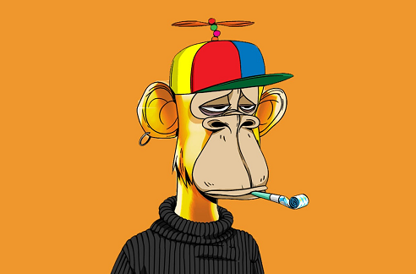
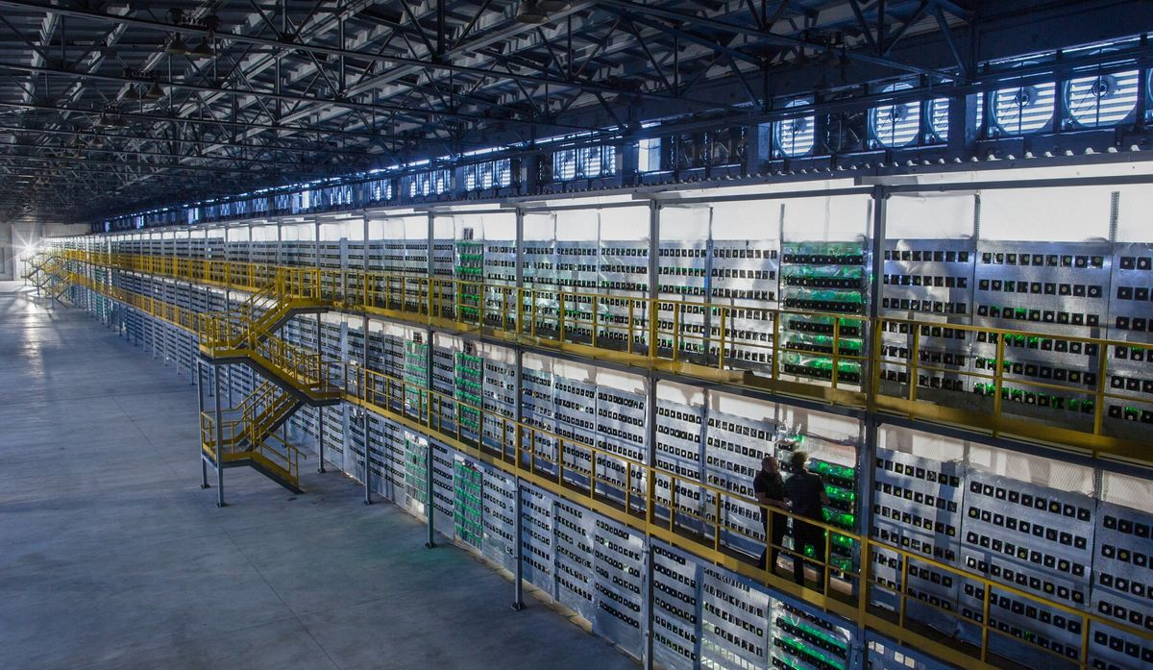
Why Blockchain
A controversial topic
Short-term issues
Blockchain is the next Cloud
2/10
Notes:
If you’ve been on twitter any time in the last year, it’s nearly impossible to avoid seeing the daily battles between the climate activists and the users with the ape profile pictures who have likely over invested into NFTs
Proof of stake (won’t get into)
Next cloud, both literally and figuratively
10 years, not having experience with cloud technologies was not a big deal for senior developers, the same thing can be said for blockchain today

Slide 4

How It Works
A distributed digital ledger
An immutable linked list
An application layer protocol
3/10

Slide 5
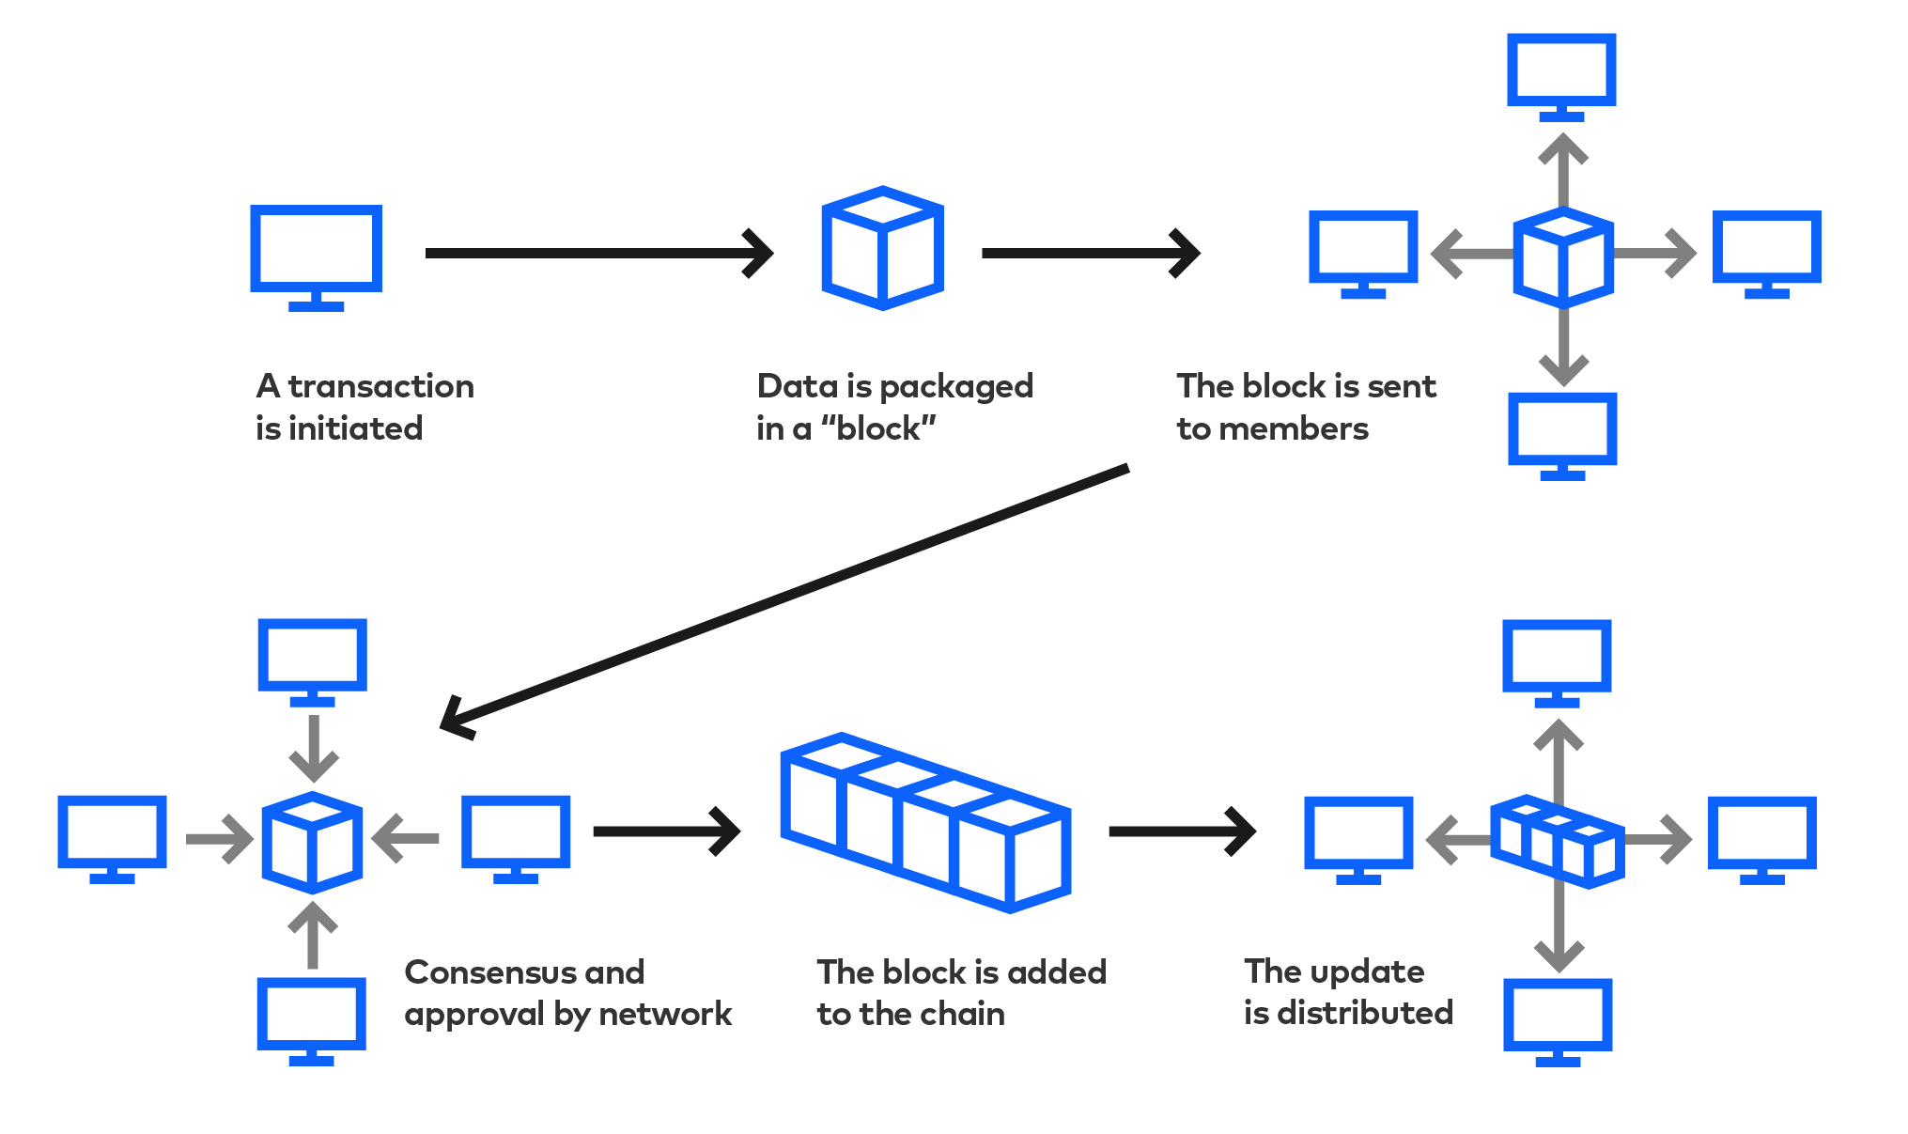
How It Works
4/10

Slide 6
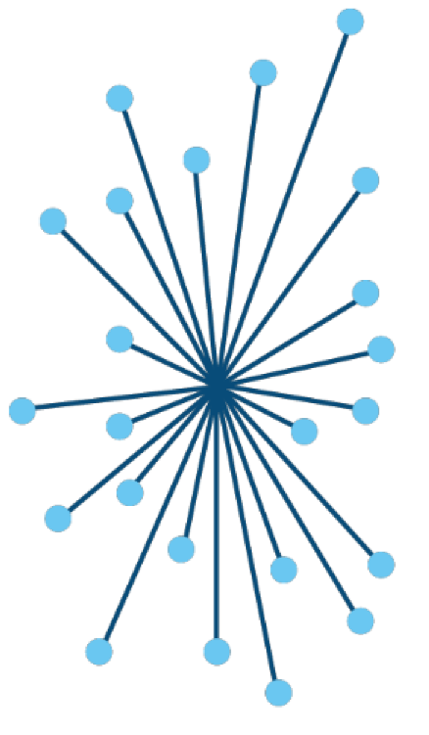
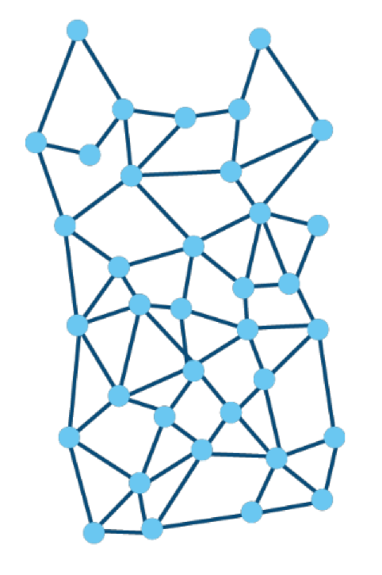
How It Works
5/10

Slide 7
Smart Contracts
Stored and executed on the blockchain
Transparent and trustless
Files of code (Solidity, Rust, C++, Python)
6/10

Slide 8
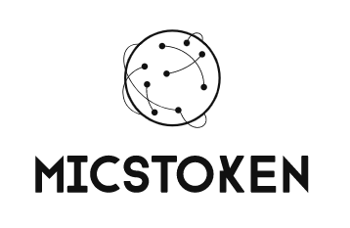
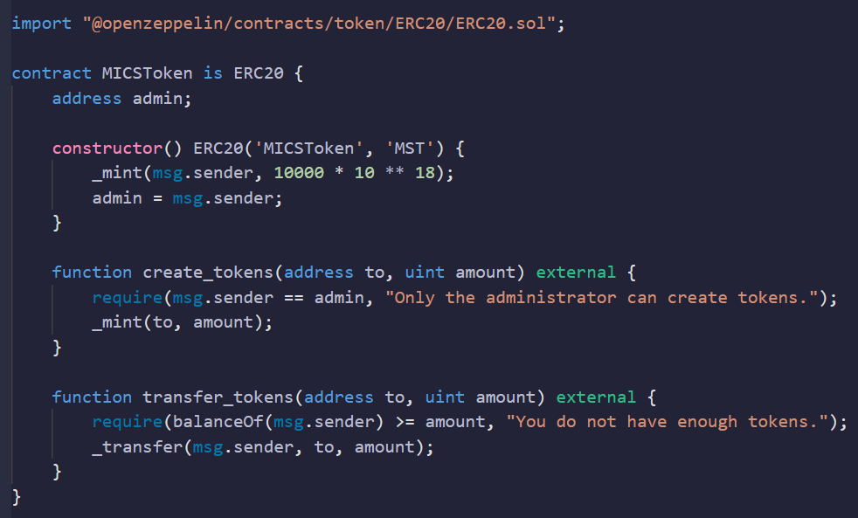
Smart Contract Example
Fungible Token
Written in Solidity
16 lines of code
7/10
Notes:
Shiba inu contract looks similar (ATH 41B USD)

Slide 9
DAOs
The entrepreneurial engineer’s best friend
‘Decentralized Autonomous Organizations’
Solve a need
-> stake claim
-> DAO
-> profit
8/10
Notes:
“If you consider yourself entrepreneurial, this is arguably the most important slide in this presentation”
Stock comparison

Slide 10
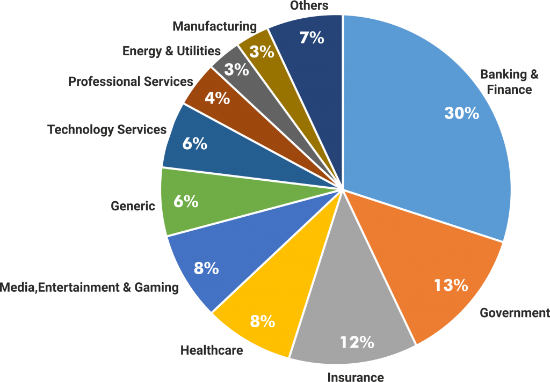
Existing DAOs
Lofty.ai
Tokenized real-estate
Exonum
Document verification
Chronicled
IoT supply chain tracking
9/10

Slide 11
Going Forward
Idea space is still vastly under-capitalized
Sets developers ahead of competition
Solve a new frontier of problems
10/10
Notes:
A new frontier
users will switch to blockchain alternatives not for ideological reasons but for utilitarian ones

Slide 12
Questions

Slide 13
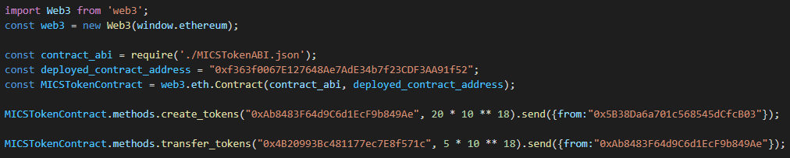
dApp Example
‘Decentralized Application’
Smart contract backend
/10

